Slide 1

SOX Audit 2020 Report
Conclusion/Rating
Project Processes Start Date
Project Target Completion
July 1, 2019
June 30, 2020
| PRIVATE & CONFIDENTIAL| Not Approved for Distribution Without Prior Approval
SOX Audit 2020 Report | Generated on February 11, 2020

Slide 2
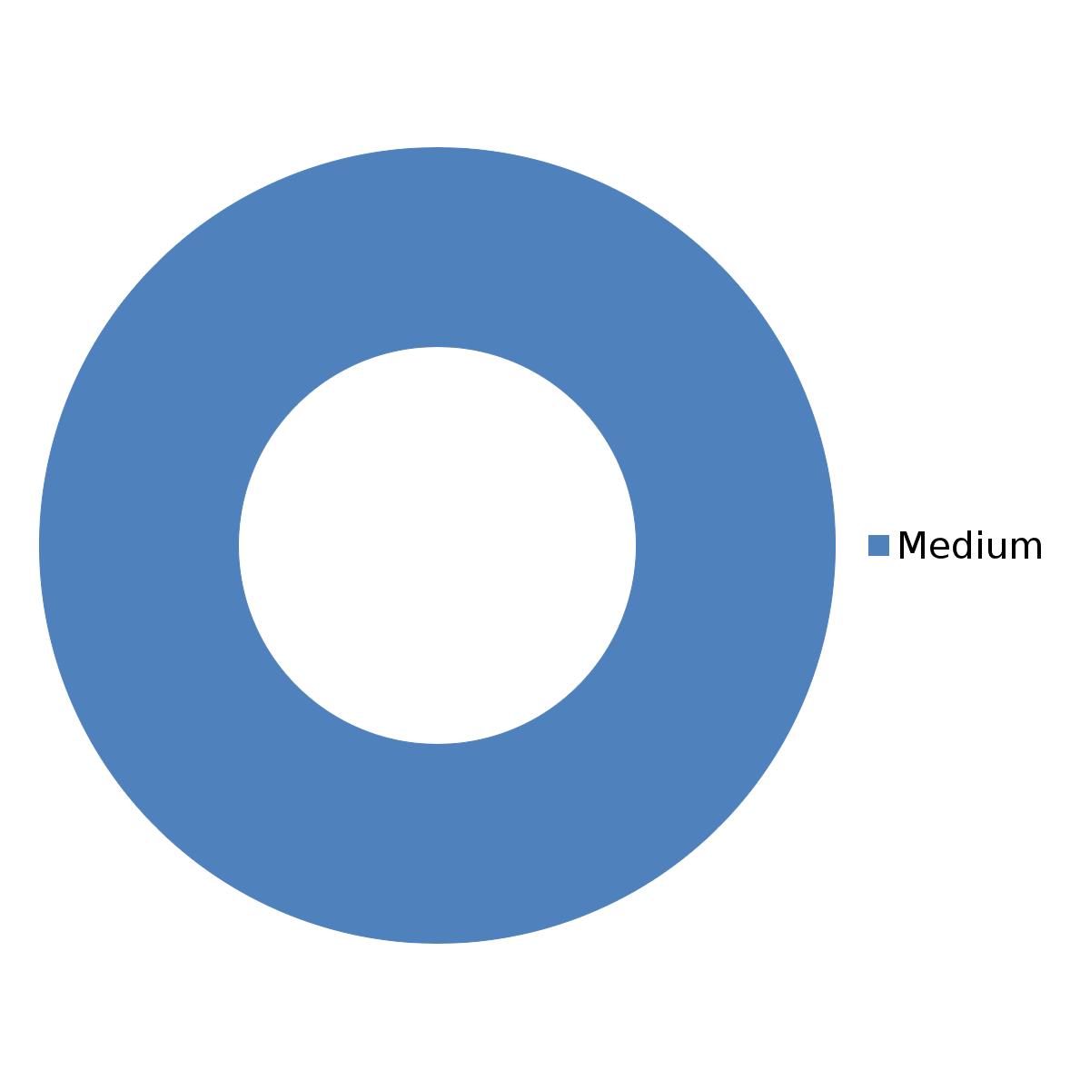
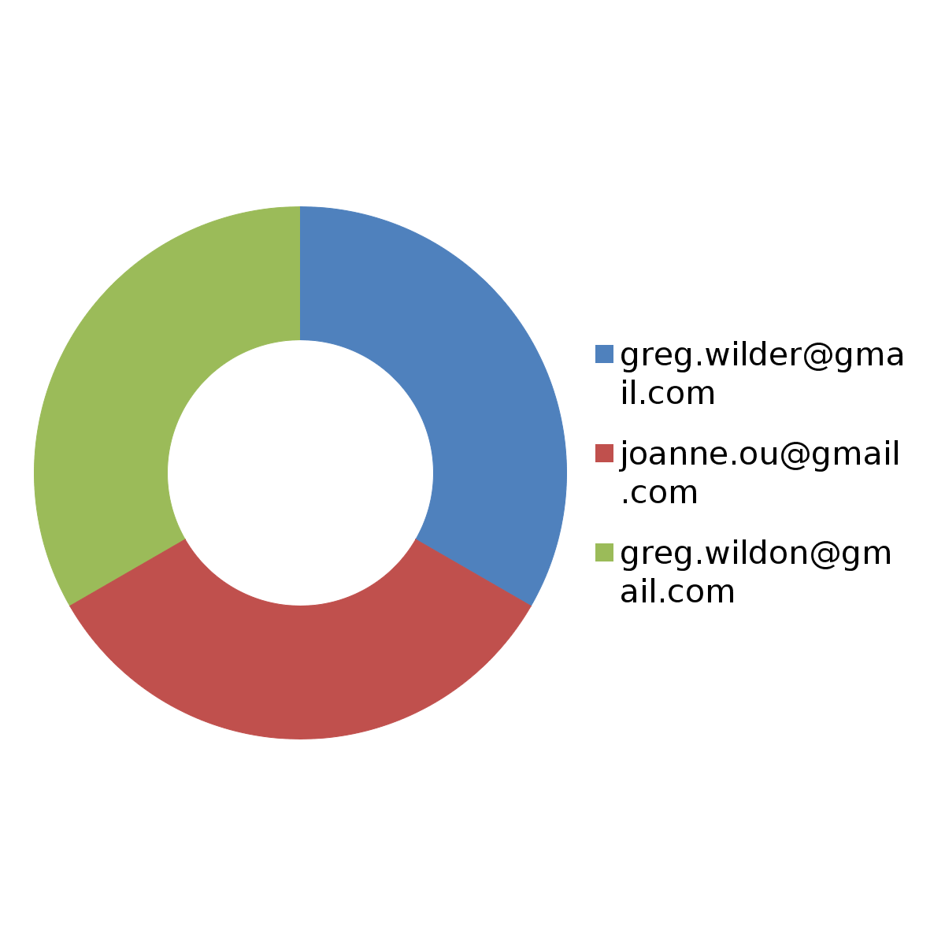
Results
Overall Assurance | Conclusion/Rating
54%
Deficiency by Severity
Deficiency by Owner
| PRIVATE & CONFIDENTIAL| Not Approved for Distribution Without Prior Approval
SOX Audit 2020 Report | Generated on February 11, 2020

Slide 3
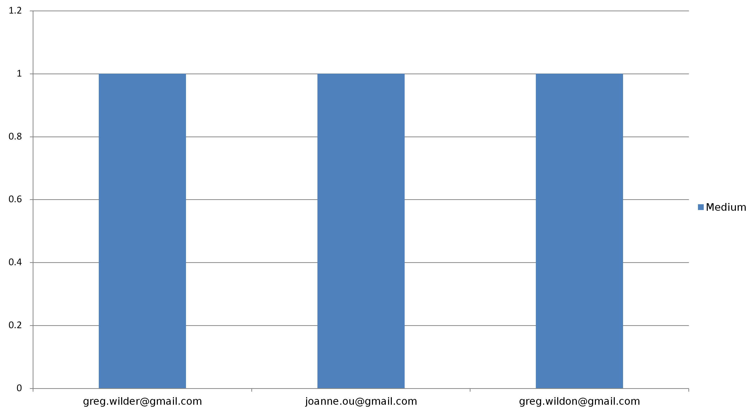
Deficiency Severity by Owner
| PRIVATE & CONFIDENTIAL| Not Approved for Distribution Without Prior Approval
SOX Audit 2020 Report | Generated on February 11, 2020

Slide 4
9 instances of MCC Code violations found
Business Processes: Procurement |  | Owner:
Owner: greg.wilder@gmail.com |  | Executive Owner:
Deficiency Information
Overall Status | Severity | Escalation Level
Open | Medium
Date Identified | Remediation Deadline | Remediation Status
January 22, 2020 | February 20, 2020 | Opened
| PRIVATE & CONFIDENTIAL| Not Approved for Distribution Without Prior Approval
SOX Audit 2020 Report | Generated on February 11, 2020

Slide 5
SLA Missing in Two Third Party Contracts
Business Processes: Information Technology General Controls |  | Owner:
Owner: joanne.ou@gmail.com |  | Executive Owner:
Deficiency Information
Overall Status | Severity | Escalation Level
Open | Medium
Date Identified | Remediation Deadline | Remediation Status
January 22, 2020 | March 31, 2020
| PRIVATE & CONFIDENTIAL| Not Approved for Distribution Without Prior Approval
SOX Audit 2020 Report | Generated on February 11, 2020

Slide 6
2 related party transactions found
Business Processes: Procurement |  | Owner:
Owner: greg.wildon@gmail.com |  | Executive Owner:
Deficiency Information
Overall Status | Severity | Escalation Level
Open | Medium
Date Identified | Remediation Deadline | Remediation Status
January 22, 2020 | February 28, 2020 | Opened
| PRIVATE & CONFIDENTIAL| Not Approved for Distribution Without Prior Approval
SOX Audit 2020 Report | Generated on February 11, 2020

